Slide 1


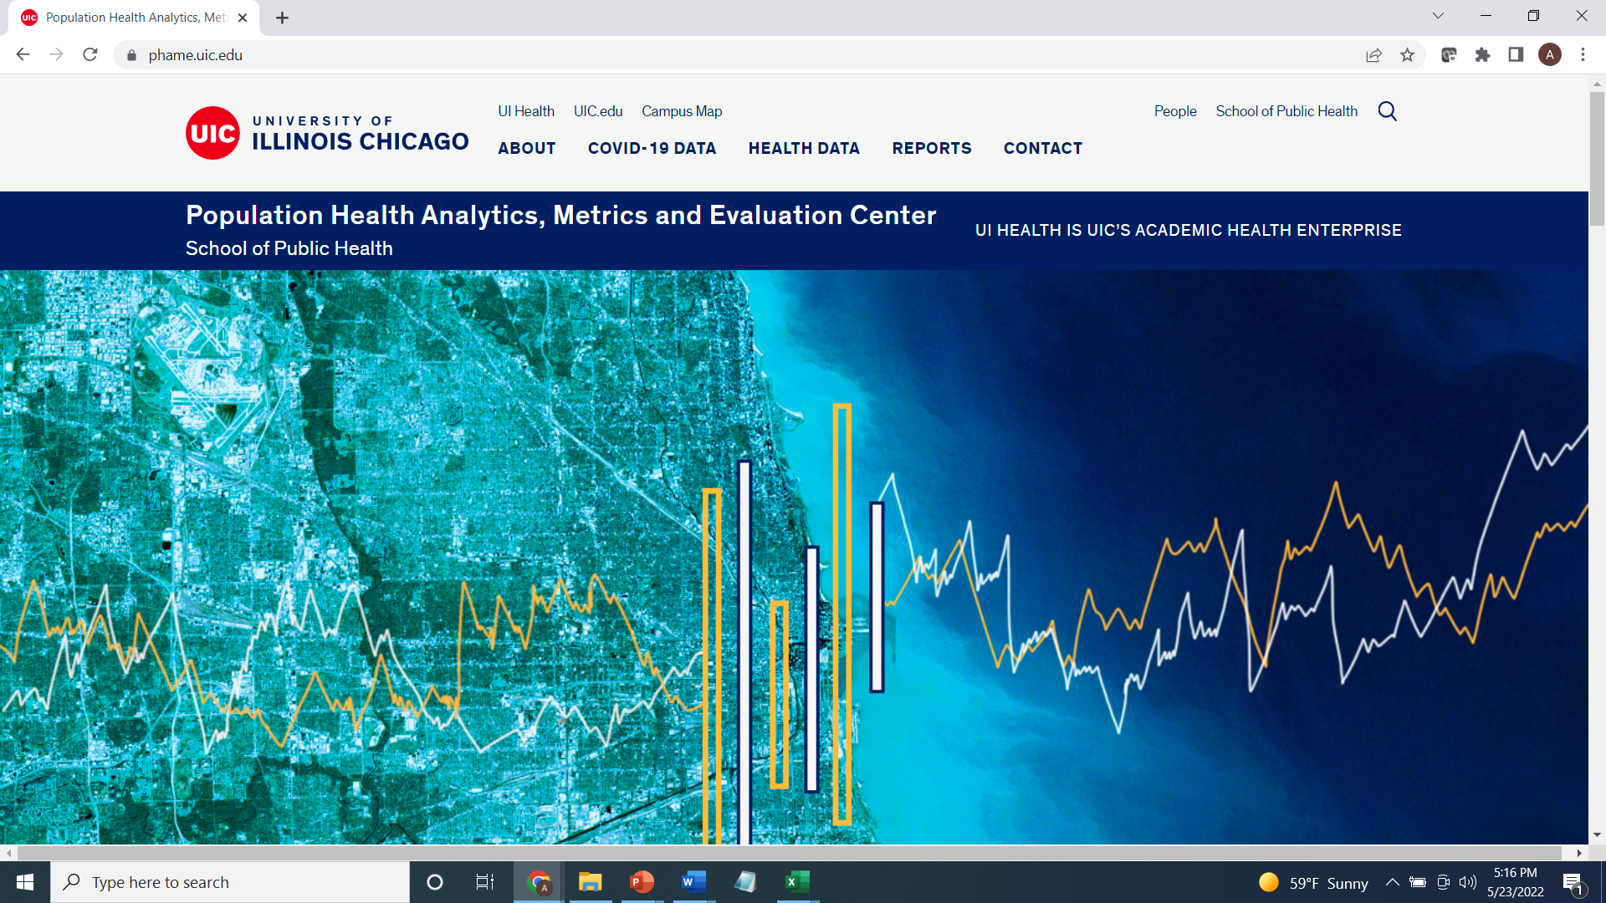

CDC Health Equity Grant 2021-2023
Activity 2.3: Increase availability, accessibility & understanding of health behavior & outcomes data by race & ethnicity.
Cook County Health Atlas Metopio + UIC PHAME
Data Capacity
Notes:
Data Capacity: Increase CCDPH’s capability to leverage data to drive, inform, evaluate, & promote CCDPH’s work & to better inform, support, & respond to the needs of key stakeholders & the community.

Slide 2

HEALTH INDICATOR CATEGORIES
Indicators on the health atlas are organized into six primary categories.
HEALTH OUTCOMES
DEMOGRAPHICS
Consequences, complications and other outcomes that result from disease (e.g., injury, hospitalization, death).
Population characteristics including community size, composition and structure (e.g., population, age, gender, race/ethnicity, migration).
The platform integrates several types of data
HEALTH BEHAVIORS
SOCIOECONOMIC
Individual activities that influence health (e.g., alcohol, drug and tobacco use; diet, physical activity, sleep).
Social and economic factors that can affect health (e.g., income, employment, education, segregation).
HEALTH CARE
PHYSICAL ENVIRONMENT
Systems and services for administering care (e.g., health screenings; primary, prenatal and dental care; clinics, hospitals, FQHCs).
Characteristics of the places where individuals where individuals live, learn, work, and play (e.g., parks, housing, air quality, water quality and transportation)
Notes:
The Cook County Department of Public Health’s Epidemiology Unit is leading an effort to design and deploy an online health atlas for suburban Cook County. We envision the atlas to be a platform for sharing a wealth of information to improve health awareness and decision-making. We are consulting with public health experts, working with other units within the department and reaching out to community members to identify what data to include.
In addition, the atlas contains several quality of life and risk indices related to public health that combine indicators across the six categories (e.g., social vulnerability index, index of concentration of extremes, neighborhood deprivation).

Slide 3
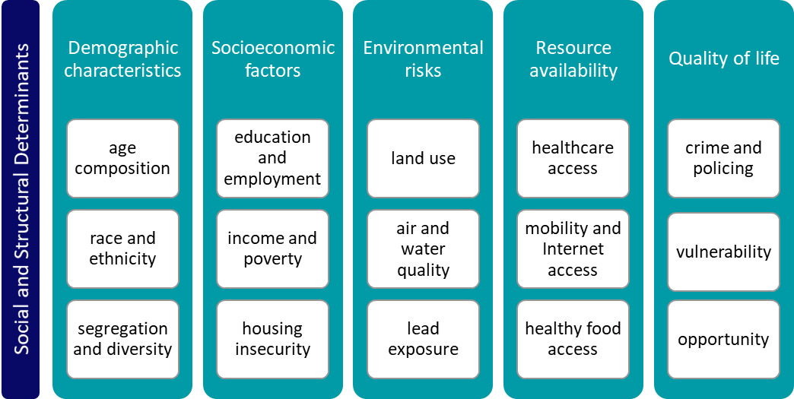
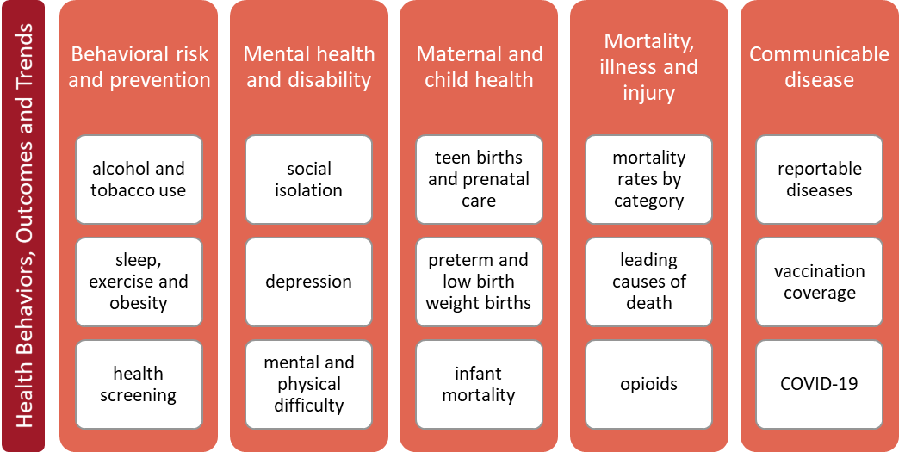
Cook County Health Atlas Indicator Categories, Topics and Data Sources
CCDPH CHSA 2021 Sections, Categories and Topics
CCDPH
Metopio
Cook County Health Survey
ACS
YRBS
BRFSS
Hospitalization
CDC
Infectious Disease
EPA
Medical Examiner
904 indicators drawn from 92 data sources
Vital Statistics
Notes:
CCDPH utilizes public health data gathered through primary data collection such as the Cook County Health Survey and the YRBS as well as from IDPH secondary data such as hospitalization, infectious disease, and vital statistic in addition to vital statistics. Our vendor, Metopio, offers curated data with 904 indicators drawn from 92 data sources.

Slide 4
HEALTH INDICATOR SUB-CATEGORIES
The six primary categories are further broken down into several subcategories.
HEALTH OUTCOMES
PHYSICAL ENVIRONMENT
HEALTH BEHAVIORS
SOCIO-ECONOMIC
Chronic disease
Infectious disease
Injury and violence
Maternal & child
Community safety
Housing
Transportation
Pollution exposure
Environmental risk
HEALTH CARE
DEMO-GRAPHICS
Income
Education
Employment & occupation
Public assistance
Alcohol & drug use
Tobacco use
Diet & exercise
Sexual activity
Population age
Sex & gender
Race, & ethnicity
Household structure
Language
Migration status
Access to care
Quality of care
Facility utilization

Slide 5
health atlas FIRST YEAR DATA RELEASE TIMELINE
The atlas will be continually updated with the latest public health information for suburban Cook County. The rollout of the data over the first year will proceed in four phases. With each phase, the Epi Unit will reach out to other CCDPH units, the county and community-based contacts for data requests and feedback.
01
02
03
04
PHASE ONE (June 2022)
PHASE TWO
(August 2022)
PHASE THREE
(October 2022)
PHASE FOUR
(April 2023)
Select indicators from CCDPH’s latest Community Health Status Assessment; Social Vulnerability; Communicable disease prevalence; Opioid deaths
2013 to 2020 birth and death rates; 2020 Youth Risk Behavioral Survey data; Environmental justice screening data
2018 to 2020 hospitalization inpatient and outpatient data
2022 Suburban Cook County Health Survey data; 2022 Youth Risk Behavioral Survey data

Slide 6
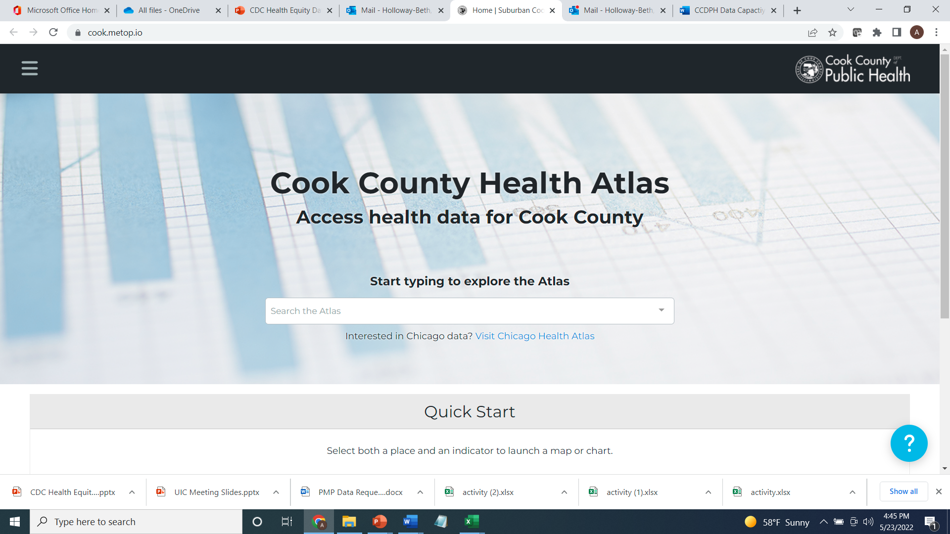
Notes:
This is the home page of the Cook County Health Atlas, you will be able navigate to indicators from this page.

Slide 7
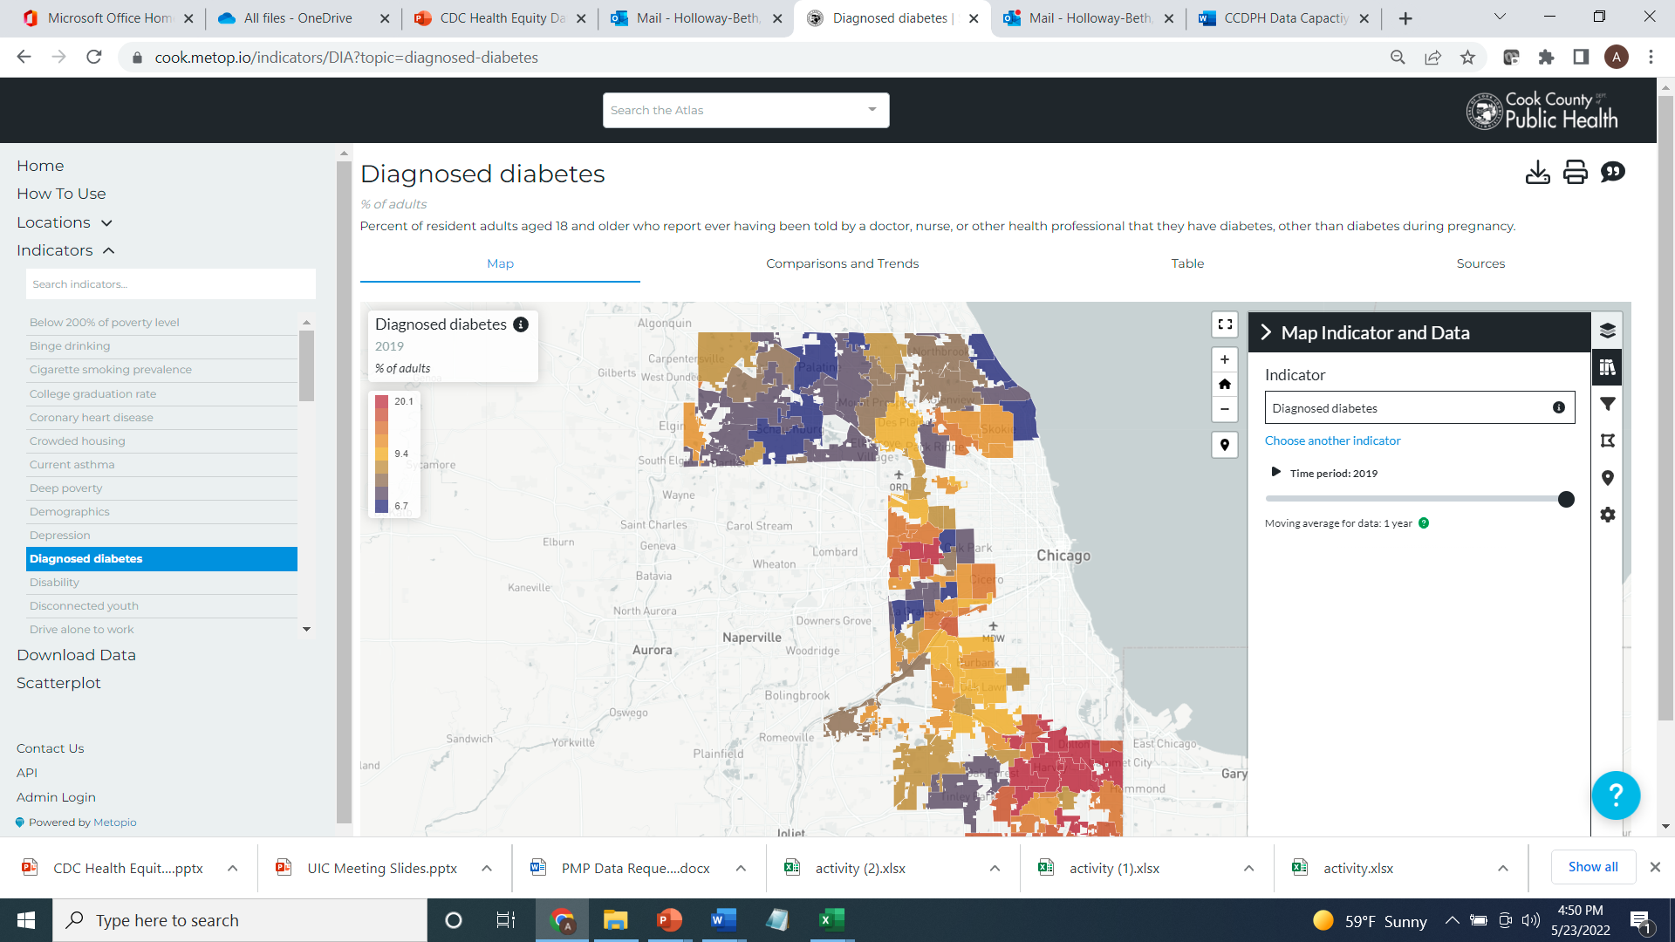

Slide 8
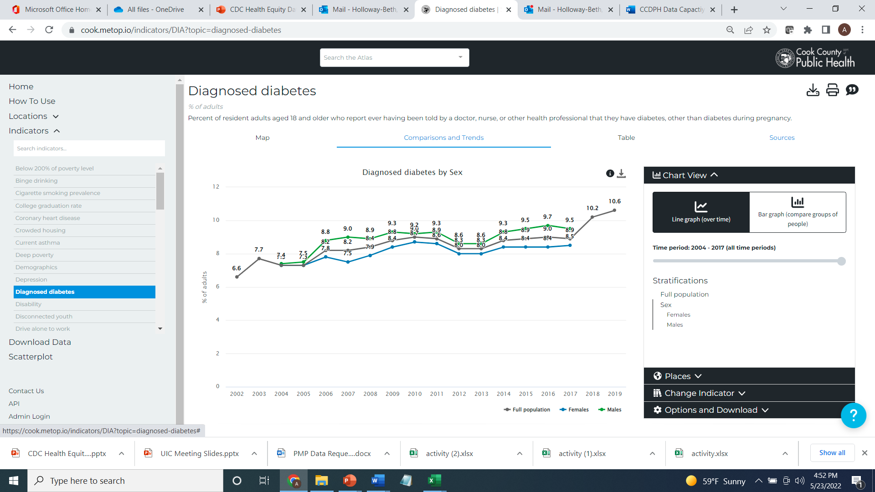
Stratifications
Diagnosed Diabetes By Sex

Slide 9
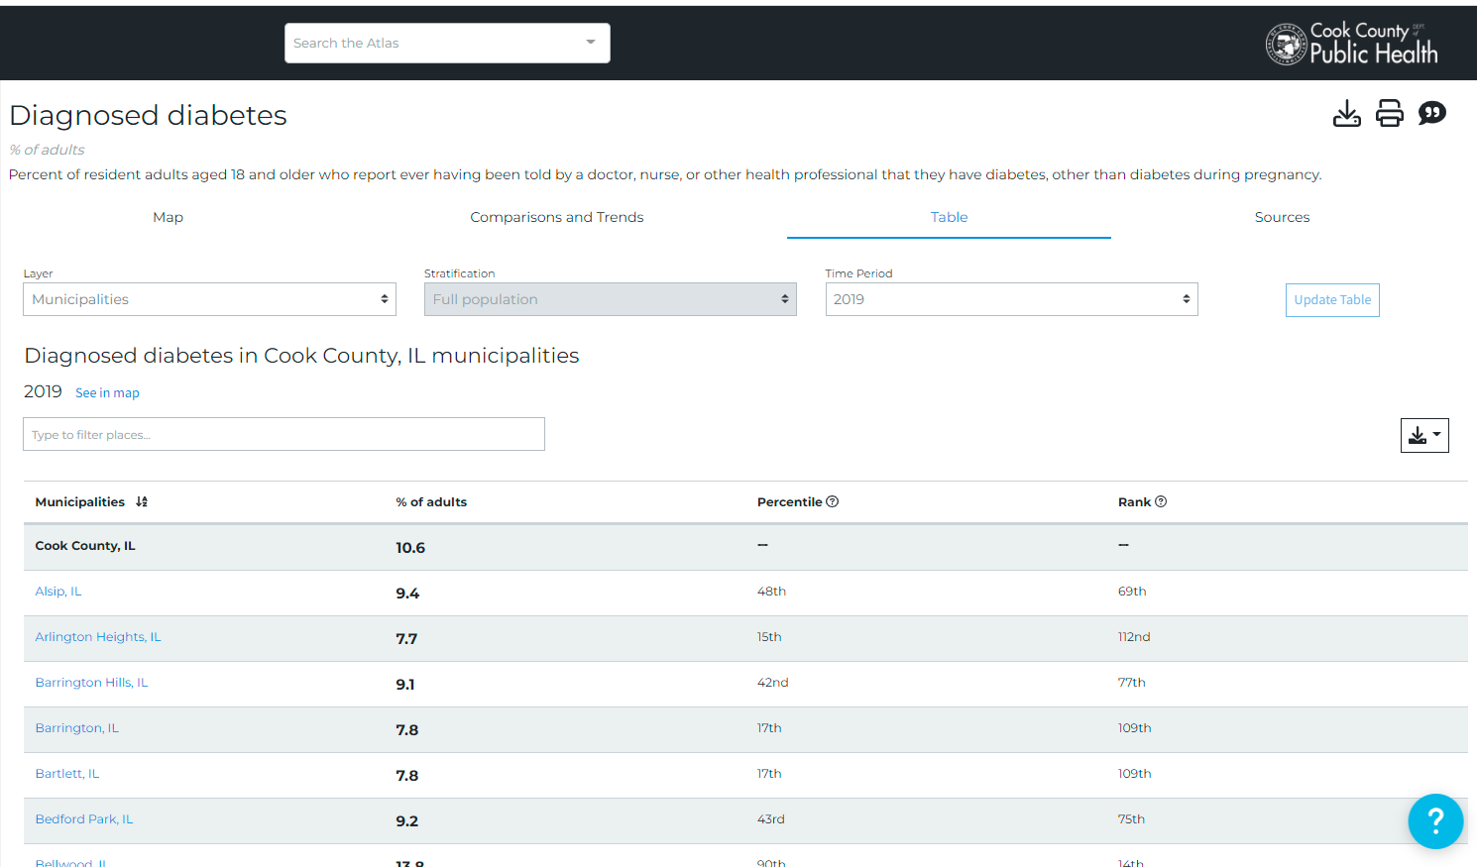
Stratifications
Diagnosed Diabetes by Municipality
Download
Button
Alsip has less
Diagnosed diabetes
than Cook County Overall

Slide 10
Health Atlas Updates
Phase 1
(June 2022)
- Select indicators from CHSA - SVI - Communicable disease prevalence - Opioid Mortality
Phase 2
(August 2022)
- Mortality - Natality - 2020 YRBS - EJ Screen data
Phase 3
(October 2022)
- 2016-2020 Hospitalization Data, in- and outpatient
Phase 4
(April 2023)
- 2022 Cook County Health Survey
- 2022 YRBS
Phased Approach
CCDPH’s Data Upload Plan
Notes:
The Suburban Cook County Health Atlas will be released in four phases. Phase one, planned for June 2022 has select indicators from the Community Health Status Assessment, Social Vulnerability Index, Communicable Disease prevalence, and Opioid Mortality. Phase two, planned for August 2022 will include the latest (2018-2020) mortality and natality rates; and self-reported health information we gathered from high-school age students via the Youth Risk Behavioral Surveillance System, 2020. Phase three, planned for October 2022, will include summaries of hospitalization (inpatient and outpatient) data (2018-2020) and Phase four will be a large update planned for April 2023 including results from our latest Cook County Health Survey data (administered summer 2022) and Youth Risk Behavioral Surveillance System (administered in fall 2022).

Slide 11
Thank You
Notes:
CCDPH is one of 107 grant recipients.

